Slide 1

Working with Files Chapter # 3 Lecture # 12, Week # 6
Dr. Muhammad Bilal Qureshi
m.qureshi@centralasian.uz
Central Asian University, Tashkent, Uzbekistan

Slide 2
Contents
File and Directory Maintenance (system calls)
chmod
chown
unlink, link, and symlink
mkdir and rmdir
chdir and getcwd
Scanning Directories (library functions)
opendir
readdir
telldir
seekdir
closedir
The /Proc File System

Slide 3
Source
Textbook:
Beginning Linux Programming 4th Edition by Neil Matthew
Chapter # 3

Slide 4
File and Directory Maintenance
The standard libraries and system calls provide complete control over the creation and maintenance of files and directories.
chmod
chown
unlink,link, symlink
mkdir and rmdir
chdir and getcwd
Notes:
gcc test.c -o test && ./test compile and run program using list

Slide 5

chmod() System Call
You can change the permission on a file or directory using chomd system call. This forms the basis of the chmod shell program.
#include<sys/stat.h>
int chmod(const char *path, mode_t mode);
The modes are already specified in the open system call, a bitwise OR of required permissions.
Unless the program has been given appropriate privalges only the owner of the file or a superuser can change its permission.

Slide 6
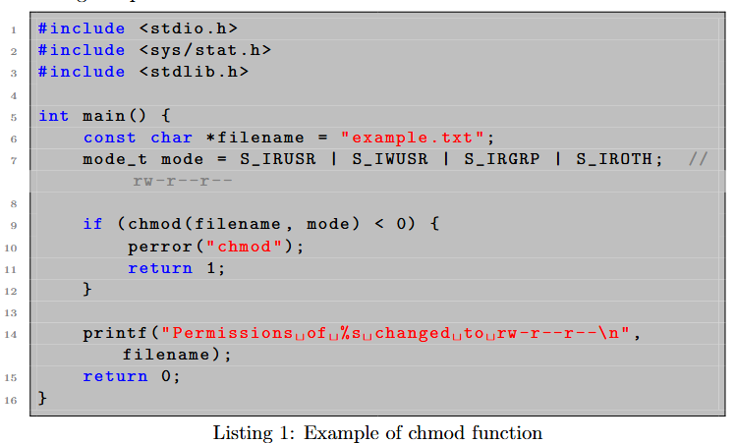
Example chmod()

Slide 7

chown() System Call
A superuser can change the owner of a file using chown system call.
#include<sys/types.h>
#include<unistd.h>
int chown(const char *path, uid_t owner, gid_t group);
The call uses numeric values of user and group IDs.
The owner and group of a file are changed if appropriate privileges are set.

Slide 8
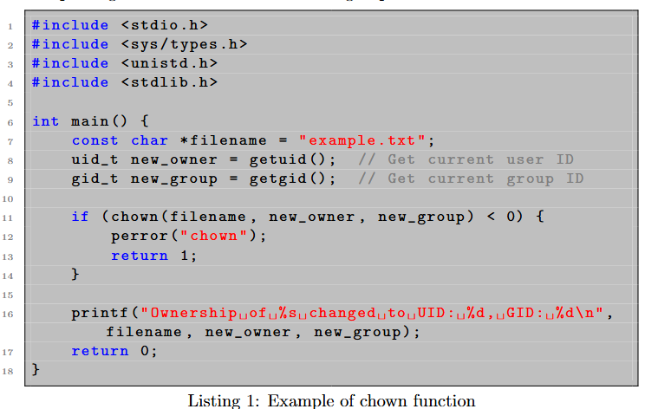
Example chown()

Slide 9
Getting group info and adding user to group
This method retrieves group information from the system database.
1. getent group groupname
To add user to specific group
1. sudo usermod -aG groupname username
aG → Adds the user (username) to the group (groupname) without removing them from other groups.
2. sudo gpasswd -a alice sudo

Slide 10
unlink, link and symlink System Calls
You can remove a file using unlink.
The unlink system call removes the directory entry for a file and decrements the link count for it. It returns 0 on successful unlinking and -1 on an error.
Requires write and execute permissions in the directory where the file has its directory entry for this call to function.
#include<unistd.h>
int unlink(const char *path);
int link(const char *path1, const char *parth2);
int symlink(const char *path1, const char *path2);

Slide 11
Cont()..
If the count reaches zero and no process has the file open the file is deleted.
Directory entry is always removed immediately but the file’s space will not be removed until the last process closes it.
The rm program uses this call.
You can create new links to file programmatically using link system call. (hard link)
You can create symbolic link using the symlink system call. (soft link)
Symbolic links to the file don’t increment the file reference count and do not prevent file from being effectively deleted as normal.
Open and unlink ->programmers' preference
Notes:
symlink() → Soft Link (Symbolic Link)
Creates a symbolic (soft) link to a file.
The symbolic link points to the original file by name.
If the original file is deleted, the symbolic link becomes broken.
Can link to files or directories.
link() → Hard Link
Creates a hard link, which is another reference to the same file inode.
The original file and hard link share the same inode.
Deleting the original file does not break the hard link.
Cannot link to directories.

Slide 12
mkdir and rmdir System Call
You can create and remove directories using the mkdir and rmdir system calls.
#include<sys/types.h>
#include<sys/stat.h>
int mkdir(const char *path, mode_t mode);
The directory permissions are passed in the parameter mode and are given in O_CREAT option of the open system call, again, subject to mask.
#include<unistd.h>
int rmdir(const char *path);
rmdir system call removes directories, but only if they are empty. The rmdir program uses this system call. (rm –r for recursive removal)

Slide 13
chdir and getcwd System Call
A program can navigate directories in much the same way a user moves around the file system. As you use the cd command in the shell to change directory, so program can use chdir system call.
#include<unistd.h>
int chdir(const char *path);
A program can determine current working directory by call the
#include<unistd.h>
char *getcwd(char *buf, size_t size);
It writes the name of current directory in given buffer, buf. It returns NULL if the directory name exceed the size of buffer, an ERANGE error.
It may also return NULL if the directory is removed (EINVAL) of permission changed (EACCESS) while the program is running.
Example

Slide 14
Scanning Directories
A common problem on Linux system is scanning directories, that is determining the files that resides in a particular directory. In shell it was easy using wildcard expression.
A standard suite of library functions has now been developed that makes directory scanning much simpler.
The directory functions are declared in a header file dirent.h.
They use a structure, DIR, as a basis for directory manipulation.
A pointer to this structure, called a directory stream (a DIR *)
Directory entries themselves are returned in dirent structure, also declared in dirent.h

Slide 15
Opendir library function
The opendir function opens a directory and establishes a directory stream. If successful, it returns pointer to a DIR structure to be used for reading directory entries
#include<syst/types.h>
#include<dirent.h>
DIR *opendir(const char *name);
Opendir returns a null pointer on failure. Uses low-level file descriptor to access directory itself, so opendir could fail with too many open files.

Slide 16
readdir library function
The readdir function returns a pointer to a structure detailing the next directory entry in the directory stream dirp. Successive calls to readdir return further directory entries.
On error or at the end returns NULL.
#include<sys/types.h>
#include<dirent.h>
struct dirent *readdir (DIR *dirp);
ino_t d-ino: The inode of the file
char d_name[]: the name of the file, for more info make a call to stat()

Slide 17
telldir library function
The telldir function returns a value that records the current position in a directory stream. You can use this in subsequent calls to seekdir to reset a directory scan to the current position.
#include<sys.types.h>
#include<dirent.h>
long int telldir(DIR *dirp);

Slide 18
seekdir library function
The seekdir function sets the directory entry pointer in the directory stream given by dirp.
The value of loc, used to set the position, should have been obtained from a prior call to telldir.
#include<sys/types.h>
#include<dirent.h>
void seekdir(DIR *dirp, longint loc);

Slide 19
closedir
The closedir function closes a directory stream and frees up the resources with it. Returns 0 on success and -1 if there’s error.
#include<sys/types.h>
#include<dirent.h>
int closedir(DIR *dirp);
Example 2:
Page # 124 (Directory Scanning Program) → go through

Slide 20
/proc file system
Linux provides a special file system, procfs, that is usually made available as the directory /proc.
It contains many special files that allow higher-level access to driver and kernel information.
Type this command $ ls /proc
$ cat /proc/cpuinfo // gives details of the processors available:
$ cat /proc/meminfo // gives information about memory usage
$ cat /proc/version // gives information about kernel version
$ cat /proc/net/sockstat //gives network socket usage statistics
$ cat /proc/sys/fs/file-max //tells total no of files that all running programs can open at the same time this can be changed directly using
# echo 80000 >/proc/sys/fs/file-max
$ cat /proc/sys/fs/file-max
$ cat /proc/sys/net/ipv4/ip_forward // should it work as a router.
Notes:
IP forwarding is enable if return 1 else disables.
watch "ls -l /proc/$(pidof top)/fd“
Show Timestamp (Epoch Time)
date +%s

Slide 21
/proc file system
Each process in Linux has a unique identifier: a number between 1 and about 32,000. The ps command provides a list of currently running processes.
neil@suse103:~/BLP4e/chapter03> ps -a
PID TTY TIME CMD
9118 pts/1 00:00:00 ftp
9230 pts/1 00:00:00 ps
10689 pts/1 00:00:01 bash
The process identifier for ftp here is given as 9118, so you need to look in /proc/9118 for details about it:
$ ls -l /proc/9118
You can tell that the program /usr/bin/pftp is running and that its current working directory is /home/neil/BLP4e/chapter03.
$ od -c /proc/9118/cmdline
Here, you can see that ftp was started with the command line ftp 192.168.0.12
$ ls /proc/9118/fd //you can see that
ftp has open descriptors 0, 1, 2, and 3, as we might expect. These are the standard input, output, and error descriptors plus a connection to the remote server.
Notes:
exec 3>&1 # Save stdout (1) to FD 3
exec 1>output.txt # Redirect stdout to a file
echo "Hello" # Goes to output.txt
exec 1>&3 # Restore stdout from FD 3
exec 3>&- # Close FD 3

Slide 22
od -c
od -c /proc/9118/cmdline is a command to display the contents of the command line used to launch process with PID 9118.
The /proc filesystem in Linux contains various virtual files that provide information about processes and other system information.
The cmdline file within the /proc directory for a specific process contains the command line arguments used to launch that process.
The od -c command is used to display the contents of a file in a human-readable format, showing each byte as a character.
In this case, it's being used to display the contents of the cmdline file in a way that shows special characters and whitespace more clearly.
Notes:
Octal dump –c(octal format)

Slide 23
cmdline options
od -c /proc/9118/cmdline
stands for "octal dump”
-c ASCII printable character
0000000 / u s r / b i n / p r o g r a m
0000020 - a r g 1 - a r g 2 - a r
0000040 g 3
0000042
hd –c/proc/9118/cmdline
Stands for “hexadecimal dump”
00000000 48 65 6c 6c 6f 2c 20 77 6f 72 6c 64 21 0a |Hello, world!.|
Notes:
Alternative
Pidof bash
ps -p 8 -o args=

Slide 24
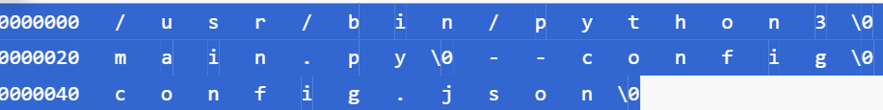
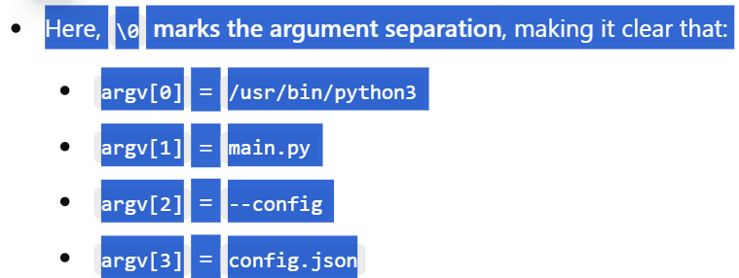
Od-c makes the argument separation more visible
Notes:
Why Use od -c?
Better visibility of arguments and their separation.
Useful for debugging scripts or applications that take multiple arguments.
Helps when arguments contain special or hidden characters.

Slide 25
Errors
The values and meanings of the errors are listed in the header file errno.h. They include
❑ EPERM: Operation not permitted
❑ ENOENT: No such file or directory
❑ EINTR: Interrupted system call
❑ EIO: I/O Error
❑ EBUSY: Device or resource busy
❑ EEXIST: File exists
❑ EINVAL: Invalid argument
❑ EMFILE: Too many open files
❑ ENODEV: No such device
❑ EISDIR: Is a directory
❑ ENOTDIR: Isn’t a directory
There are a couple of useful functions for reporting errors when they occur: strerror and perror.

Slide 26
Thank You
Questions?

